Slide 1
Objectives
In this session, you will learn to:
  Set up account heads
  Understand inventory accounting
  Create stock groups
  Create stock categories
  Create godowns or locations
Notes:
Share the session objectives with the students.

Slide 2

Setting up Account Heads
Lets us have a look on the Trial Balance of National Traders extracted from the Accounts at the close of business on
March 31, 2009.
Notes:
Share the session objectives with the students.

Slide 3
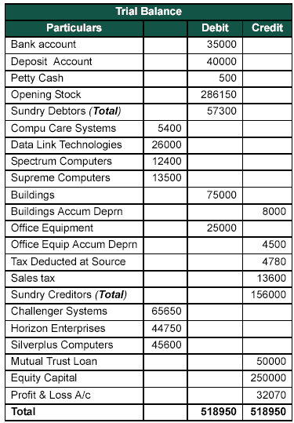
Setting up Account Heads (Contd.)
The following figure shows the Trial Balance of National Traders.
Notes:
Share the session objectives with the students.

Slide 4
Setting up Account Heads (Contd.)
Charts of Accounts for National Traders:
  The following are the various accounts to be prepared based on the given Trial Balance of National Traders:
    Capital Accounts
    Revenue Accounts
Notes:
Share the session objectives with the students.

Slide 5
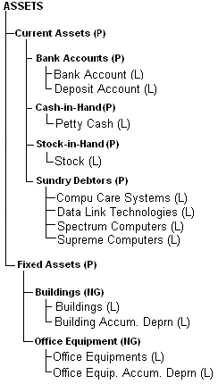
Setting up Account Heads (Contd.)
  The following figure shows the capital accounts as appearing in the assets side of the balance sheet.
Notes:
Share the session objectives with the students.

Slide 6
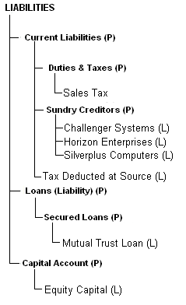
Setting up Account Heads (Contd.)
  The following figure shows the capital accounts as appearing in the liabilities side of the balance sheet.
Notes:
Share the session objectives with the students.

Slide 7
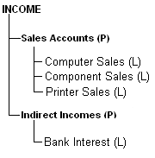
Setting up Account Heads (Contd.)
  The following figure shows the chart of accounts for the incomes to be reflected in Profit & Loss account.
Notes:
Share the session objectives with the students.

Slide 8
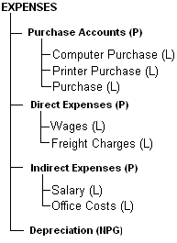
Setting up Account Heads (Contd.)
  The following figure shows the chart of Accounts for the expenses to be reflected in Profit & Loss account.
Notes:
Share the session objectives with the students.

Slide 9
Setting up Account Heads (Contd.)
Let us see how to create Group Names for National Traders.
Notes:
You need to perform the step given under the following topic:
Page No 53

Slide 10

Setting up Account Heads (Contd.)
How can we alter Groups in Tally.ERP 9?
Notes:
You need to perform the step given under the following topic:
Chapter 4 Page No 57 and 58

Slide 11
Setting up Account Heads (Contd.)
Groups can be altered by selecting the Alter option for single or multiple groups.
Notes:
You need to perform the step given under the following topic:
Chapter 4 Page No 57 and 58

Slide 12
Setting up Account Heads (Contd.)
Let us see how to create National Traders ledgers with opening balances.
Notes:
You need to perform the step given under the following topic:
Page No 60

Slide 13
Setting up Account Heads (Contd.)
Let us see how to Alter and Display Ledgers.
Notes:
You need to perform the step given under the following topic:
Page No 60

Slide 14
Setting up Account Heads (Contd.)
How can we delete Ledgers in Tally.ERP 9?
Notes:
You need to perform the step given under the following topic:
Chapter 4 Page No 57 and 58

Slide 15
Setting up Account Heads (Contd.)
You can delete a ledger, by pressing Alt+D in the Ledger Alteration screen.
Notes:
You need to perform the step given under the following topic:
Chapter 4 Page No 57 and 58

Slide 16
Setting up Account Heads (Contd.)
How can we verify
the Ledgers and Opening Balances in Tally.ERP 9?
Notes:
You need to perform the step given under the following topic:
Chapter 4 Page No 57 and 58

Slide 17
Setting up Account Heads (Contd.)
To verify the Ledgers and Opening Balances in Tally.ERP 9, you need to perform the following task:
Go to the Gateway of Tally > Accounts Info. > Ledgers >Alter (Multiple Ledgers) > All Items
Notes:
You need to perform the step given under the following topic:
Chapter 4 Page No 57 and 58

Slide 18
Understanding Inventory Accounting
Inventory Accounting Includes:
  Recording of stock details
  Providing information on stock availability
Tally.ERP 9 makes it possible to integrate the inventory and accounting systems so that the financial statements reflect the closing stock value from the Inventory system.
The inventory system operates in much similar manner as the accounting system, as shown in the following steps:
  Set up the inventory details, which is a similar operation to creating the chart of accounts although, in this case, there are no pre-defined set of stock groups.
  Create the individual stock items, which is similar to setting up the ledgers.

Slide 19
Understanding Inventory Accounting (Contd.)
In a newly created company, the Inventory Info. menu comprises the following types of Masters:
  Stock Groups
  Stock Items
  Units of Measure
  Voucher Types

Slide 20
Understanding Inventory Accounting (Contd.)
How can we view the Inventory Info.
menu in Tally.ERP 9?
Notes:
You need to perform the step given under the following topic:
Chapter 4 Page No 57 and 58

Slide 21
Understanding Inventory Accounting (Contd.)
To view the Inventory Info. menu, you need to perform the following tasks:
Go to the Gateway of Tally > Inventory Info.
Notes:
You need to perform the step given under the following topic:
Chapter 4 Page No 57 and 58

Slide 22
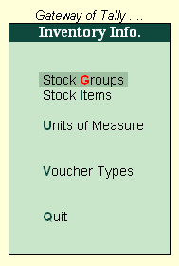
Understanding Inventory Accounting (Contd.)
The following figure shows the Inventory Info. menu.
Notes:
Share the session objectives with the students.

Slide 23
Understanding Inventory Accounting (Contd.)
Let us understand the process of creating an inventory system through the scenario of Indus Enterprises.
Notes:
4.1.1 Creating Stock Group

Slide 24
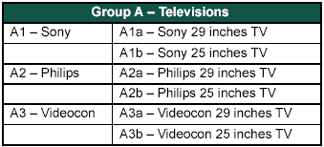
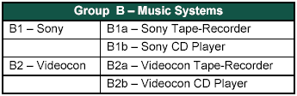
Understanding Inventory Accounting (Contd.)
Indus Enterprises sells
Televisions
Music Systems
Under the stock group Televisions, create stock groups based on the different brands being sold such as Sony, Philips and Videocon.
Under the stock group Music Systems, create stock groups based on the different brands being sold such as Sony and Videocon.
Notes:
Share the session objectives with the students.

Slide 25
Creating Stock Groups
Stock Groups:
  It helps in the classification of stock items.
  It helps in identifying the stock items and reporting them in the statements.
Notes:
Share the session objectives with the students.

Slide 26
Creating Stock Groups (Contd.)
Let us see how to create a Stock Group.
Notes:
You need to perform the steps given under the following topic:
4.1.1 Creating Stock Group

Slide 27
Creating Stock Categories
Stock Categories:
  The Stock Categories feature offers the following classification of stock items:
    Stock Groups
    Stock Categories
  It allows categorising the stock items together (based on functionality) across different stock groups.
  This categorisation enables you to obtain reports for alternatives or substitutes of a stock item.
Notes:
Share the session objectives with the students.

Slide 28
Creating Stock Categories (Contd.)
For a newly created company in Tally.ERP 9, the Stock Categories option is not available in the Inventory Info. menu. How can we
get this option in the Inventory Info. menu?
Notes:
You need to perform the step given under the following topic:
Chapter 4 Page No 57 and 58

Slide 29
Creating Stock Categories (Contd.)
You need to set the Maintain Stock Categories option to YES in F11: Features (F2: Inventory Features) to get an additional option Stock Categories under Inventory Info.
Notes:
You need to perform the step given under the following topic:
Chapter 4 Page No 57 and 58

Slide 30
Creating Stock Categories (Contd.)
Let us see how to create a Stock Category.
Notes:
You need to perform the steps given under the following topic:
4.2.1 Creating Stock Category

Slide 31
Creating Godowns/Locations
Godowns/Locations:
  A place where stock items are stored is referred to as Godowns.
Notes:
Share the session objectives with the students.

Slide 32
Creating Godowns/Locations (Contd.)
For a newly created company in Tally.ERP 9, the Godowns is not available in the Inventory Info. menu. How can we get this
option in the Inventory
Info. menu?
Notes:
You need to perform the step given under the following topic:
Chapter 4 Page No 57 and 58

Slide 33
Creating Godowns/Locations (Contd.)
You need to set the Maintain Multiple Godowns option in F11: Features (F2: Inventory Features) to get the additional option Godowns under the Inventory Info. menu.
Notes:
You need to perform the step given under the following topic:
Chapter 4 Page No 57 and 58

Slide 34
Creating Godowns/Locations (Contd.)
Let us see how to create a Godown.
Notes:
You need to perform the steps given under the following topic:
4.3.1 Creating a Godown

Slide 35
Summary
In this session, you learnt that:
  You can delete a ledger by pressing Alt+D in the Ledger Alteration screen.
  Inventory accounting includes recording stock details like the purchase of stock, the sale of stock, stock movement between storage locations or godowns and providing information on stock availability.
  Stock Groups are provided for the purpose of classification of stock items.
  Stock Items refers to goods that you manufacture or trade.
  Godowns/Location are places where stock items are stored.

